Slide 1
Class Diagram for Flaunt
Team 2

Slide 2
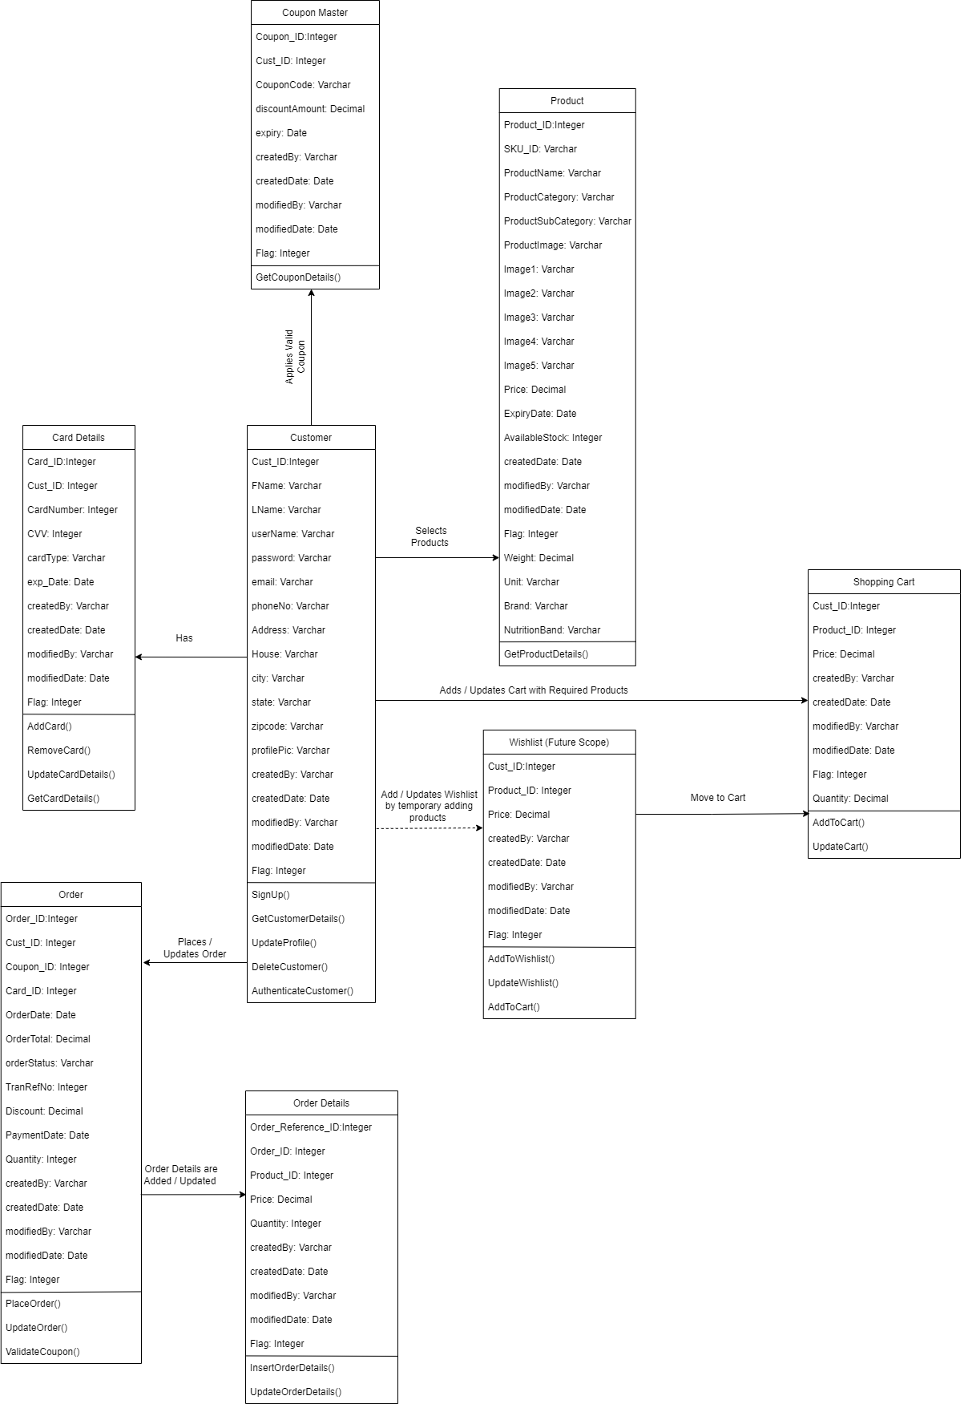
Class Diagram Application: Flaunt Website

